Slide 1




Naming Identifiers
Naming Variables, Methods, Parameters, Properties, Constants, Classes, Interfaces, Etc.
SoftUni Team
Technical Trainers
Software University
http://softuni.bg

Slide 2

Table of Contents
General Naming Guidelines
Naming Classes / Types / Applications
Naming Classes, Interfaces, Types, Delegates, Enumerations, Namespaces, Files, Folders, Assemblies, Applications
Naming Methods and Method Parameters
Naming Variables and Constants
Other Naming Guidelines

Slide 3

General Naming Guidelines
Naming
Guidelines

Slide 4

General Naming Guidelines
Always use English
English is the only language that all software developers speak
Avoid abbreviations
Example: scrpCnt vs. scriptsCount
Avoid hard-to-pronounce names
Example: dtbgRegExPtrn vs. dateTimeBulgarianRegExPattern

Slide 5



Use Meaningful Names
Always prefer meaningful names
Names should answer these questions:
What does this class do? What is the intent of this variable? What is this variable / class used for?
Examples:
FactorialCalculator, studentsCount, Math.PI, configFileName, CreateReport
Incorrect examples:
k, k2, k3, junk, f33, KJJ, button1, variable, temp, tmp, temp_var, something, someValue

Slide 6
Names Should Be Meaningful in Their Context
Whether a name is meaningful or not depends on its context (its enclosing type)
Examples of meaningful names:
Generate() in the class LabyrinthGenerator
Find(string fileName) in the class FileFinder
Deposit(decimal amount) in the class Account
Examples of meaningless names:
Generate() in the class Program
Find(string name) in the class Program

Slide 7
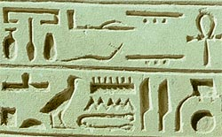
Fake Meaningful Names
Junior developers often use "fake" meaningful names that are in fact meaningless
Bad naming examples:
Topic6Exercise12, LoopsExercise12, Problem7, OOPLecture_LastExercise
Yes, Topic6Exercise12 indicates that this is solution to exercise 12, but what is it about?
Sum of numbers or Tetris game?
Better naming:
MaximalNumbersSubsequence

Slide 8

Naming Classes, Types and Application Components
Classes and Types

Slide 9
Naming Classes and Types
Naming types (classes, structures, etc.)
Use PascalCase character casing
In C#, JavaScript, Java, PHP
Examples:
RecursiveFactorialCalculator, TreeSet, XmlDocument, IEnumerable, Color, TreeNode, InvalidTransactionException, MainForm
Incorrect examples:
recursiveFactorialCalculator, recursive_factorial_calculator, RECURSIVE_FACTORIAL_CALCULATOR

Slide 10
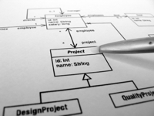
Naming Classes and Structures in C#, JavaScript, Java and PHP
Use the following formats:
[Noun]
[Adjective] + [Noun]
Examples:
Student, FileSystem, BinaryTreeNode, Constants, MathUtils, CheckBox, Calendar
Incorrect examples:
Move, FindUsers, Fast, ExtremlyFast, Optimize, Check, FastFindInDatabase

Slide 11
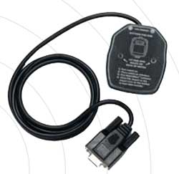
Naming Interfaces in C#
Following formats are acceptable:
'I' + [Verb] + 'able'
'I' + [Noun], 'I' + [Adjective] + [Noun]
Examples:
IEnumerable, IFormattable, IDataReader, IList, IHttpModule, ICommandExecutor
Incorrect examples:
List, iFindUsers, IFast, IMemoryOptimize, Optimizer, FastFindInDatabase, CheckBox

Slide 12
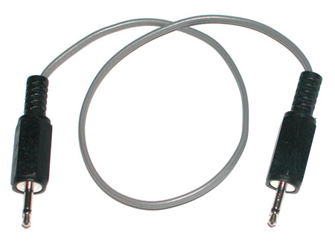
Naming Interfaces in Java
Following formats are acceptable:
[Verb] + 'able'
[Noun], [Adjective] + [Noun]
Examples:
Serializable, Enumerable, Comparable, Runnable, CharSequence, OutputStream
Incorrect examples:
list, FindUsers, Run, Inumber, OPTIMIZER, IMemoryOptimize, FastFindInDatabase

Slide 13
Naming Interfaces in PHP
Following formats are acceptable:
[Noun] + 'Interface', [Adjective] + [Noun] + 'Interface'
Examples:
PersonInterface, MonitorInterface, PhoneInterface, OptimizerInterface
Incorrect examples:
iPersonInterface, IMonitor, phoneInterface, Optimizer, Optimizer_Interface

Slide 14

Naming Enumerations in C#
Several formats are acceptable:
[Noun] or [Verb] or [Adjective]
Use the same style for all members
Examples:
enum Day { Monday, Tuesday, Wednesday, … }, enum AppState { Running, Finished, … }, enum WindowState { Normal, Maximized, … }
Incorrect examples:
enum Color {red, green, blue, white}, enum PAGE_FORMAT {A4, A5, A3, LEGAL, …}

Slide 15

Naming Enumerations in Java and JS
Several formats are acceptable:
[Noun] or [Verb] or [Adjective]
Use PascalCase for the enumeration and CAPITALS for its members
Examples:
enum Suit {CLUBS, DIAMONDS, HEARTS, SPADES}, enum Color {RED, GREEN, BLUE, …}
Incorrect examples:
enum Color {red, green, blue, white}, enum PAGE_FORMAT {A4, A5, A3, LEGAL, …}

Slide 16

Naming Special Classes C#
Attributes
Add 'Attribute' as suffix
Example: WebServiceAttribute
Incorrect example: WebService
Collection Classes
Add 'Collection' as suffix
Example: StringsCollection
Incorrect example: ListOfStrings

Slide 17

Naming Special Classes C# (2)
Exceptions
Add 'Exception' as suffix
Use informative name
Example: FileNotFoundException
Incorrect example: FileNotFoundError
Delegate Classes
Add 'Delegate' or 'EventHandler' as suffix
Example: DownloadFinishedDelegate
Incorrect example: WakeUpNotification

Slide 18

The Length of Class Names
How long could be the name of a class / struct / interface / enum / delegate?
The name should be as long as required
Don't abbreviate the names if this could make them unclear
Examples: FileNotFoundException, CustomerSupportNotificationService
Incorrect examples: FNFException, CustSuppNotifSrvc

Slide 19


Naming Namespaces in C# and PHP
Namespaces naming guidelines
Use PascalCase
Following formats are acceptable:
Company . Product . Component . …
Product . Component . …
Example:
Microsoft.WinControls.GridView
Incorrect examples:
Microsoft_WinControlsGridView, Classes

Slide 20
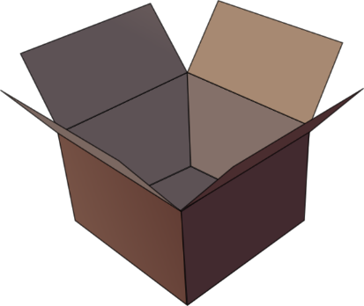
Naming Java Packages / JS Namespaces
Packages naming guidelines
Use camelCase
Following formats are acceptable:
com . company . product . component . …
product . component . …
Example:
com.apple.quicktime, hibernate.core
Incorrect examples:
IBM.DB2.Data, ibm.db2_data, Tetris.UI

Slide 21

Naming Project Folders
Project folders' names should follow the project namespaces / packages
Examples:
com
apple
quicktime
com.apple.quicktime…
Incorrect examples:
com_apple_quicktime, quicktime.src

Slide 22
Naming Files in C#, Java and PHP
Files with source code should have names matching their content
File containing a class Student should be names Student.cs / Student.java / Student.php
Example:
StudentDAO.cs, Constants.java, CryptographyAlgorithms.cs
Incorrect examples:
Program.cs, SourceCode.java, _d2.cs, WebApplication1.jsp, Page1.aspx

Slide 23
Naming Files in JavaScript
myapp.invoice.js
Use small letters and hyphens for JavaScript file names (+ optionally .min + version)
Put a single library / component in a single file
Examples:
jquery-1.8.2.min.js, widgets.js, scriptaculous.js
Incorrect examples:
jQuery_classes.js, Widgets.js, MyAjax.Library.js, jQuery-1.8.2.js

Slide 24

Naming .NET Assemblies
.NET assembly names should follow the root namespace in its class hierarchy
Examples:
Oracle.DataAccess.dll
Interop.CAPICOM.dll
Microsoft.WinControls.GridView.dll
Incorrect examples:
OracleDataAccess.dll
Microsoft_WinControlsGrid_View.dll

Slide 25
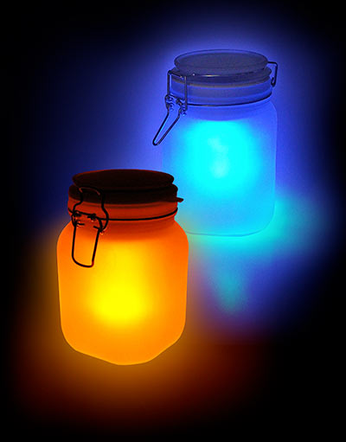
Naming JAR Files in Java
JAR files names should consist of single word or several words separated by hyphen
Can contain version information
Examples:
xalan25.jar
ant-apache-log4j.jar
Incorrect examples:
Ant.Apache.Log4J.jar
Oracle.JDBC.Drivers.jar

Slide 26

Naming Applications
Applications should be named meaningfully
Use [Noun] or [Adjective] + [Noun]
Use PascalCase
Examples:
BlogEngine
NewsAggregatorService
Incorrect examples:
ConsoleApplication4, WebSite2
zadacha_14, online_shop_temp2

Slide 27

Naming Methods/Functions and Parameters
Methods
Parameters

Slide 28

Naming Methods
Methods naming guidelines
Use meaningful method names
Method names should answer the question:
What does this method do?
If you cannot find a good name for a method, think about whether it has a clear intent
Examples: FindStudent, LoadReport, Sine
Incorrect examples: Method1, DoSomething, HandleStuff, SampleMethod, DirtyHack

Slide 29

Naming Methods (2)
Use PascalCase for C# and camelCase for JavaScript, PHP and Java
Example (C#): LoadSettings
Example (JS/PHP/Java): loadSettings
Prefer the following formats:
[Verb], [Verb] + [Noun], [Verb] + [Adjective] + [Noun]
Examples: Show, LoadSettingsFile, FindNodeByPattern, toString, printList
Incorrect examples: Student, Generator, counter, White, Approximation, mathUtils

Slide 30
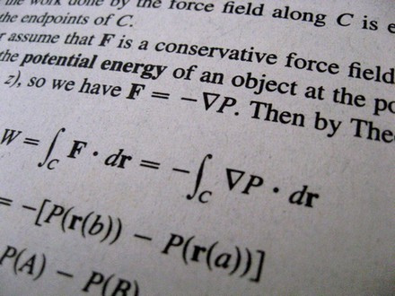
Methods Returning a Value
Methods returning values should describe the returned value
Examples:
ConvertMetersToInches, not MetersInches or Convert or ConvertUnit
Meters2Inches is still acceptable
CalculateSinus is good but Sinus is still acceptable
Ensure that the unit of measure is obvious
Prefer MeasureFontInPixels to MeasureFont

Slide 31
Single Purpose of All Methods
Methods should have a single purpose!
Otherwise they cannot be named well
How to name a method that creates annual incomes report, downloads updates from internet and scans the system for viruses?
CreateAnnualIncomesReportDownloadUpdatesAndScanForViruses is a nice name, right?
Methods that have multiple purposes (weak cohesion) are hard to be named
Need to be refactored instead of named

Slide 32

Consistency in Methods Naming
Use consistent naming in the entire project
LoadFile, LoadImageFromFile, LoadSettings, LoadFont, LoadLibrary, but not ReadTextFile
Use consistently the opposites at the same level of abstraction:
LoadLibrary vs. UnloadLibrary, but not FreeHandle
OpenFile vs. CloseFile, but not DeallocateResource
GetName vs. SetName, but not AssignName

Slide 33

The Length of Method Names
How long could the name of a method be?
The name should be as long as required
Don't abbreviate, your IDE has autocomplete
Examples (C#):
LoadCustomerSupportNotificationService, CreateMonthlyAndAnnualIncomesReport
Examples (JS/Java/PHP):
loadCustomerSupportNotificationService, createMonthlyAndAnnualIncomesReport
Incorrect examples:
LoadCustSuppSrvc, CreateMonthIncReport

Slide 34

Naming Method Parameters (C#, Java, JS, PHP)
Method parameters names
Preferred form: [Noun] or [Adjective] + [Noun]
Should be in camelCase
Should be meaningful
Unit of measure should be obvious
Examples: firstName, report, speedKmH, usersList, fontSizeInPixels, font
Incorrect examples: p, p1, p2, populate, LastName, last_name, convertImage

Slide 35

Naming Variables and Constants

Slide 36

Naming Variables
Variable names
Should be in camelCase
Preferred form: [Noun] or [Adjective] + [Noun]
Should explain the purpose of the variable
If you can't find good name for a variable check if it has a single purpose
Exception: variables with very small scope, e.g. the index variable in a 3-lines long for-loop
Names should be consistent in the project

Slide 37

Naming Variables – Example
Examples:
firstName, report, config, usersList, fontSize, maxSpeed, font, startIndex, endIndex, charsCount, configSettingsXml, dbConnection, createUserSqlCommand
Incorrect examples:
foo, bar, p, p1, p2, populate, LastName, last_name, LAST_NAME, convertImage, moveMargin, MAXSpeed, _firtName, __temp, firstNameMiddleNameAndLastName

Slide 38
More about Naming Variables
The name should address the problem we solve, not to the means used to solve it
Prefer nouns from the business domain to computer science terms
Examples:
accounts, customers, customerAddress, accountHolder, paymentPlan, vipPlayer
Incorrect examples:
paymentsPriorityQueue, playersArray, accountsLinkedList, customersHashtable

Slide 39
Naming Boolean Variables
Give to boolean variables names that imply true or false
Use positive boolean variable names
Incorrect example:
Examples:
hasPendingPayment, customerFound, validAddress, positiveBalance, isPrime
Incorrect examples:
notFound, findCustomerById, player, programStop, run, list, isUnsuccessfull
if (!notFound) { … }

Slide 40

Naming Special Variables
Naming counters
Establish a convention, e.g. [Noun] + 'Count'
Examples: ticketsCount, customersCount
State
Establish a convention, e.g. [Noun] + 'State'
Examples: blogParseState, threadState
Variables with small scope and span
E.g. loop counters
Short names can be used, e.g. index, i, u

Slide 41
Temporary Variables
Do you really think temporary variables exist?
All variables in the program are temporary because are used temporary only during the program execution?
Temporary variables can always be named better than temp or tmp:
// Swap a[i] and a[j]
int temp = a[i];
a[i] = a[j];
a[j] = temp;
// Swap a[i] and a[j]
int oldValue = a[i];
a[i] = a[j];
a[j] = oldValue;

Slide 42
The Length of Variable Names
How long could be the name of a variable?
Depends on the variable scope and live time
More "famous" variables should have longer and more descriptive name
Acceptable naming examples:
Unacceptable naming examples:
for (int i = 0; i < users.Length; i++)
if (i % 2 == 0)
sum += users[i].Weight;
class Student {
private string lastName;
}
class LinkedList {
public int flag { get; set; }
}
class Student {
private int i;
}

Slide 43

Naming Constants in C#
Use PascalCase
Use meaningful names that describe their value
Examples:
Incorrect examples:
private const int ReadBufferSize = 8192;
private const int DefaultFontSizeInPixels = 16;
public static readonly PageSize DefaultPageSize = PageSize.A4;
public const int Max = 512; // Max what? Apples or Oranges?
public const int Buf256 = 256; // What about BUF256 = 1024?
public const string Greater = "&gt;"; // GreaterHtmlEntity
public const int FontSize = 16; // 16pt or 16px?
public const PageSize PAGE_SIZE = PageSize.A4; // PascalCase Convention!

Slide 44
Naming Constants in JavaScript, Java, PHP
Use CAPITAL_LETTERS for JavaScript / Java / PHP constants
Use meaningful names
Constants should describe their value
Examples:
Incorrect examples:
public static final int READ_BUFFER_SIZE = 8192;
public static final PageSize DEFAULT_PAGE_SIZE = PageSize.A4;
public static final int FONT_SIZE_IN_POINTS = 16;
public static final int NAME = "BMW"; // What name? Person name?
public static final int BufSize = 256; // Use CAPITALS
public static final int font_size_pixels = 16; // Use CAPITALS

Slide 45

Other Naming Guidelines

Slide 46
Never Give Misleading Name!
Giving a misleading name is even worse than giving a totally unclear name
Example:
Consider a method that calculates the sum of all elements in an array
Good names: Sum or CalculateSum
Bad names: CalculateAverage or Max or CheckForNegativeNumber?
It's crazy, but be careful with "copy-paste-driven-development"

Slide 47
What's Wrong with This Code?
FileStream fs = new FileStream(FILE_NAME, FileMode.CreateNew);
// Create the writer for data.
BinaryWriter w = new BinaryWriter(fs);
// Write data to Test.data.
for (int i = 0; i < 11; i++)
{
w.Write( (int) i);
}
w.Close();
fs.Close();
// Create the reader for data.
fs = new FileStream(FILE_NAME, FileMode.Open, FileAccess.Read);
BinaryReader r = new BinaryReader(fs);
// Read data from Test.data.
for (int i = 0; i < 11; i++)
{
Console.WriteLine(r.ReadInt32());
}
r.Close();
fs.Close();
Source: http://msdn.microsoft.com/en-us/library/36b93480.aspx

Slide 48
Naming Identifiers
https://softuni.bg/courses/high-quality-code/

Slide 49

License
This course (slides, examples, demos, videos, homework, etc.) is licensed under the "Creative Commons Attribution-NonCommercial-ShareAlike 4.0 International" license
Attribution: this work may contain portions from
"High Quality Code" course by Telerik Academy under CC-BY-NC-SA license

Slide 50







SoftUni Diamond Partners

Slide 51





Free Trainings @ Software University
Software University Foundation – softuni.org
Software University – High-Quality Education, Profession and Job for Software Developers
softuni.bg
Software University @ Facebook
facebook.com/SoftwareUniversity
Software University @ YouTube
youtube.com/SoftwareUniversity
Software University Forums – forum.softuni.bg

